Slide 1
Balmoral Orchards Homeowners Association 2021 Annual Meeting
September, 2021

Slide 2
Balmoral Orchards - Meeting Agenda
Neighborhood Business
Review/approval of 2020 meeting minutes
Treasury/Balance Sheet
Dues Status
Officer Intro/Election
Old/New Business
Township Info
New Neighbors
Other Topics
Notes:
2

Slide 3
Balmoral Orchards – Association Balance Sheet
Beginning Balance (1/1/2021) $17,220.27
HOA Dues Receipts $7,625.00
(includes past due year payments)
Expenses
DTE Energy ($245.38)
Lawn Maintenance (half year) ($2,000.00)
Fees ($24.00)
Miscellaneous (Legal) ($250.00)
HOA Insurance ($534.59)
Party Reimbursements (846.46)
Ending Balance: 8/26/20201 $21,443.78
Notes:
3

Slide 4
Balmoral Orchards – Dues Status
56 Members have paid dues in-full (Thank you!)
8 Members have unpaid dues.
Total Outstanding Dues: ($1,030)
Dues notices will be sent in January, 2022 and collected by January 31, 2022.
After February 28, 2022, all outstanding dues will be assessed a $25 late fee.
Notes:
4

Slide 5
Balmoral Officers
 | Current
President | Peter Rosinski
Vice President | Eric Pearson
Secretary | Carol Pearson
Treasurer | Carlos Guerrero
Any volunteers interested to assume a Board position?
Additional volunteers welcome!
Social chair
Motion to approve/reject the current Board?
Notes:
5

Slide 6
Old/New Business
Social Calendar: Do we proceed for the coming year?
Halloween Parade/Party, Balmoral Ladies Holiday Get-Together, Spring/Summer Block Party?
New ideas:
Food Trucks: Balmoral has hosted twice so far. Interest in continuing? Ideas for types of food truck?
Roads: Is there interest in repairing our roads?
Kirkwood has completed its 3 yr project.
Final cost for 170 homes: $11,457/home (26% below original estimate)
Balmoral independent investigation has secured quotes of appr. $3,000/home (10yr life) and $5,600/home (20yr life)
Culverts, landscape repair, etc. not included
More investigation/discussion needed.
This topic is raised annually at our POA meetings, but participation is too low to gauge interest.

Slide 7
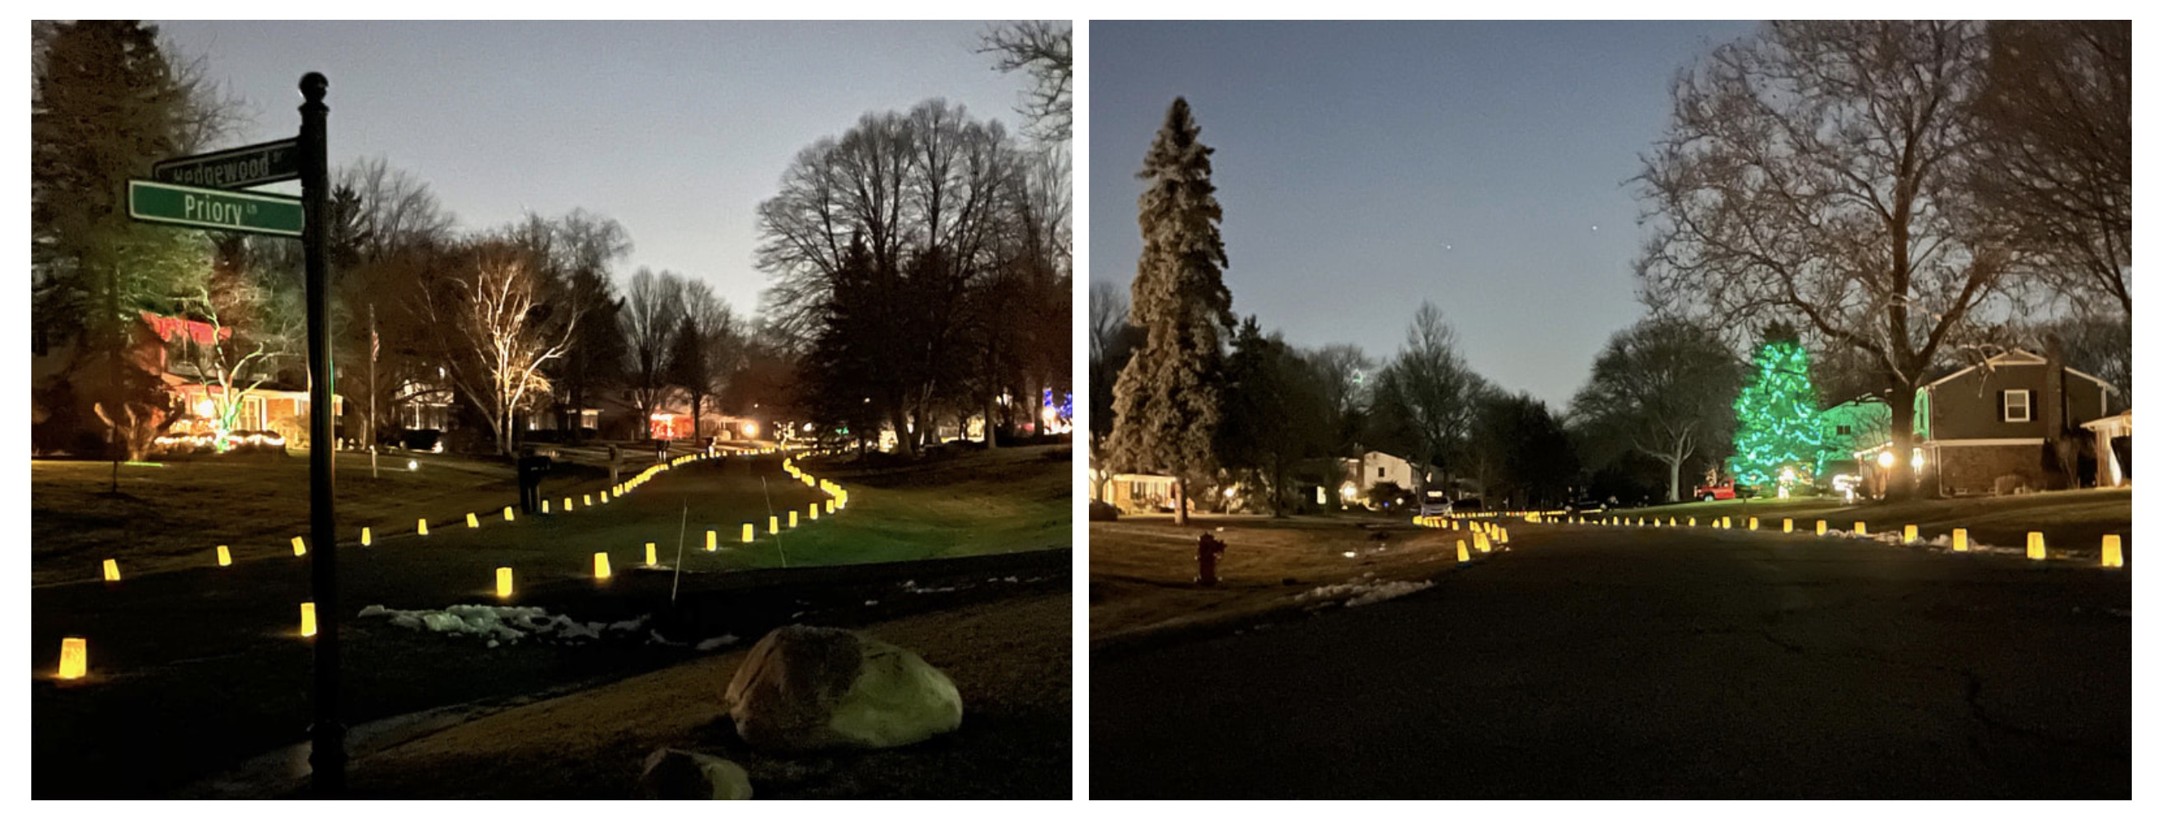
Old/New Business
Luminaries: a success in 20/21 on NY Eve: repeat?
Notes:
7
7

Slide 8
Old/New Business
By-laws:
The current by-laws can be found on the Balmoral Orchards website.
Pending MI state legislation regarding HOA bylaws/restrictions has prompted a review of BOPOA bylaws.
New drafts have been prepared and are being reviewed.
Revised bylaws would need POA approval, and then be registered with the state.
Investigation ongoing.
Notes:
8
8

Slide 9
Bloomfield Township Ordinance Questions?
Ordinances and Resolutions
If you have an Ordinance question, complaint or comment, there are several ways to contact the Ordinance Division: Phone 248-594-2845 Submit a Form by Fax 248-433-7729 Submit an Online Form by Email The Ordinance Division will respond to you as soon as possible.
http://www.bloomfieldtwp.org/
Notes:
9

Slide 10
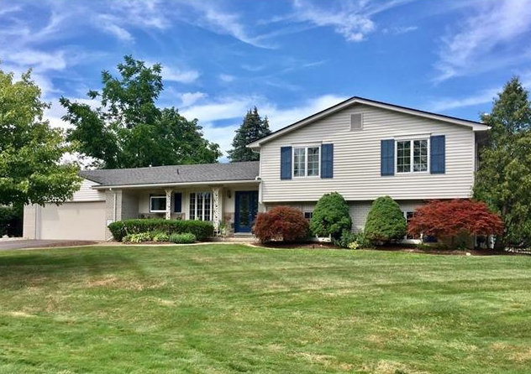
New to Balmoral Orchards?
As a homeowner, you are automatically a member of the BOPOA
Contact anyone on the Board for help getting acquainted with the neighborhood.
You are welcome to get involved in our community!

Slide 11
Other Ideas/Suggestions?!
Thanks!

