Slide 1
Balmoral Orchards Property Owners Association 2023 Annual Meeting
October 17, 2023

Slide 2
Balmoral Orchards - Meeting Agenda
Neighborhood Business
Review/approval of 2022 meeting minutes
Officer Intro/Election/Board Position
Treasury/Balance Sheet/Dues status
Old/New Business
Township Info
New Neighbors
Other Topics
Notes:
‹#›

Slide 3
Balmoral Officers
 | Current
President | Peter Rosinski
Vice President | Eric Pearson
Secretary | Carol Pearson
Treasurer | Carlos Guerrero
Any volunteers interested to assume a Board position?
Motion to approve/reject the current Board for 2023/2024 term?
Additional volunteers welcome!
Social chair
Notes:
‹#›

Slide 4
Balmoral Orchards – Association Balance Sheet
Beginning Balance (10/16/2023) $24,955.14
HOA Dues Receipts $7,475.00
(includes past due year payments)
Expenses
DTE Energy ($421.97)
Lawn Maintenance ($6,007.00)
Postage ($46.00)
HOA Insurance ($1029.82)
Party Reimbursements ($1375.25)
Notes:
‹#›

Slide 5
Balmoral Orchards – Dues Status
56 Members have paid dues in-full (Thank you!)
8 Members have unpaid dues.
Notes:
‹#›

Slide 6
Old/New Business
Social Calendar: How do we proceed for the coming year?
We need volunteers to lead planning for events or else they will not happen.
A Social Chair is most welcome to coordinate new ideas.
Roads:
Preliminary interest survey indicated some interest in taking steps to investigate
General mood seems not very excited under current economic conditions, so we won’t rush the process.
Engaging the township to approve an engineering assessment of our roads is the next step. This should not incur any cost to the neighborhood.

Slide 7
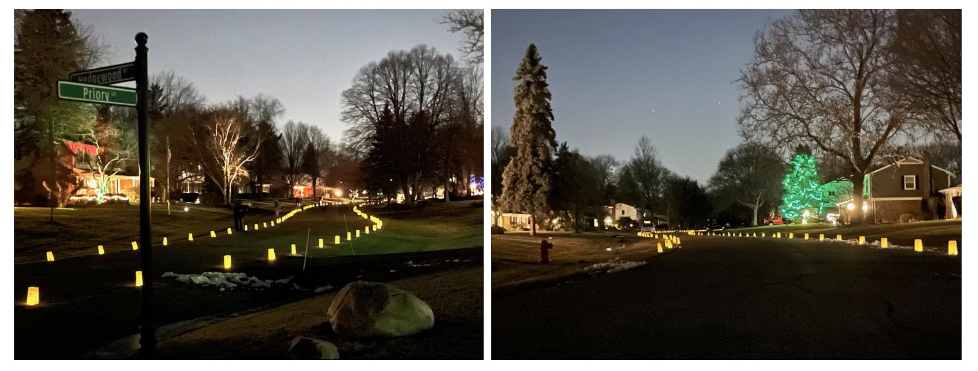
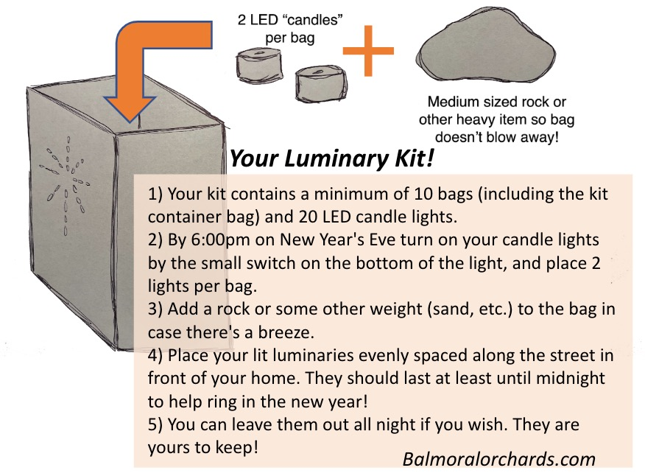
Old/New Business
Luminaries: a continuing Balmoral tradition! Watch for more information toward year end.
Notes:
‹#›
‹#›

Slide 8
Old/New Business (Carol)
By-laws:
MI State legislation changes going into effect in March of 2024 regarding HOA restrictions prompted a review of BOPOA Deed Restrictions.
We were advised that we must refile our Deed Restrictions as well as take steps before they can be refiled. These steps include filing Articles of Incorporation, securing an EIN (Employer Identification Number) from the IRS as well as filing for non-profit status.
We have successfully filed the Articles of Incorporation and are in the process of securing the EIN and non-profit status. Once all three steps are completed, the Deed Restrictions will be refiled.
Notes:
‹#›
‹#›
WE TIED UP LOOSE ENDS ADMINISTRATIVELY

Slide 10
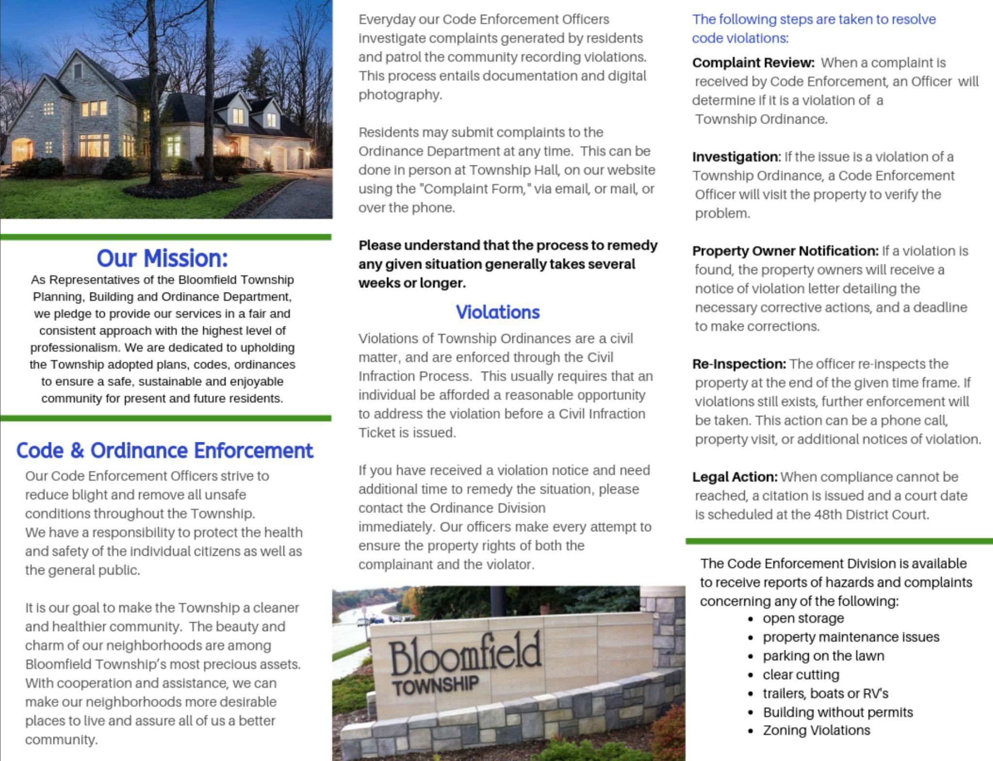
Appendix

Slide 11
Bloomfield Township Ordinance Questions?
Ordinances and Resolutions
It starts with you
Escalation to HOA board (if attempts fail)
Escalate to Township
If you have an Ordinance question, complaint or comment, there are several ways to contact the Ordinance Division: Phone 248-594-2845 Submit a Form via email The Ordinance Division will respond to you as soon as possible.
http://www.bloomfieldtwp.org/
Notes:
‹#›

Slide 12
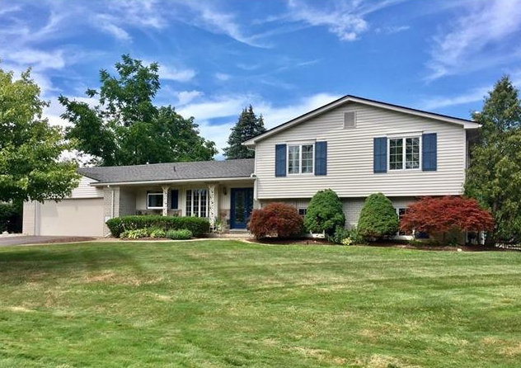
New to Balmoral Orchards?
As a homeowner, you are automatically a member of the BOPOA - please submit or update your email/contact info via our website
Contact anyone on the Board for help getting acquainted with the neighborhood.
You are welcome to get involved in our community!

Slide 13
Other Ideas/Suggestions?!
Thanks!

